Slide 1
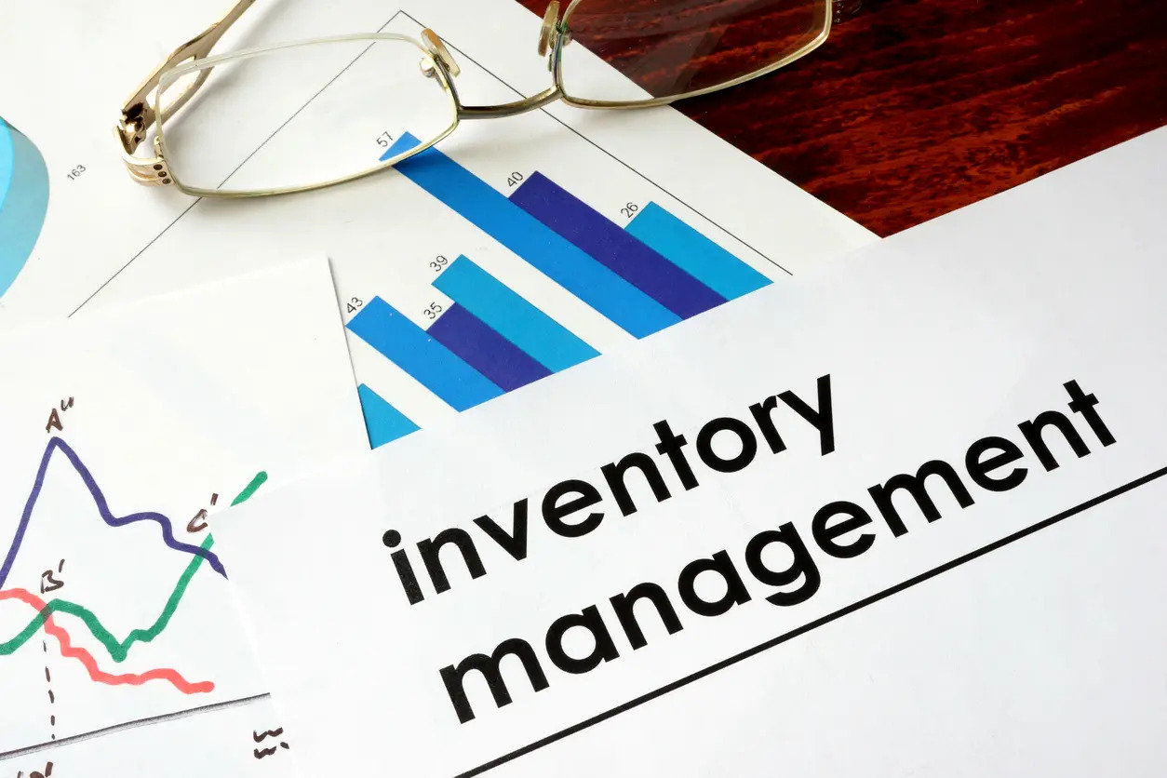
INVENTORY MANAGEMENT SYSTEM
Unnimaya P U
S4 MCA - B

Slide 2
Contents
Introduction
Objectives
Relevance
Existing system & Proposed system
Modules
Tools , Framework and Programming Language

Slide 3
Introduction
Inventory management is the backbone of any business operations. With the development of technology and availability of process driven software applications, inventory management has undergone revolutionary changes.
In any business or organization, all functions are interlinked and connected to each other and are often overlapping. Inventory management is a very important function that determines the health of the supply chain as well as the impacts the financial health of the balance sheet. Every organization constantly strives to maintain optimum inventory to be able to meet its requirements and avoid over or under inventory that can impact the financial figures.

Slide 4
The system provides following features:
User may add/update/delete inventory.
User may add/update inventory details.
Details include cost, quantity and description.
Includes forms for inventory inwards and outwards.
User may create sub inventories.
An interactive user interface.
A flexible inventory management system.

Slide 5
It is an inventory project that deals with the college inventory’s details , if the college department need a dozen of printers, CPUs and other things they will make an intent, then after the approval of head, the intent reaches the purchasing team . They make the quotations then select the best out of that and deals with the suppliers and make the order .

Slide 6
Relevance
This system is mainly used for reducing the manual work in the college and make it as system process. It is a computerized process and all the transactions might be happened through this. It helps the authorities for balancing the total stock during the end of the year

Slide 7
Existing system & Proposed system
In the existing system, when the required stock is not available in the warehouse. The officials might buy it from store outside and may not be included in the balance stock record.
But in the proposed system, every thing that has been bought for use in departments and offices whether it be from the warehouse or outside shops will be recorded in the inventory.

Slide 8
Objectives
Maintaining Sufficient Stock
Supplies should be easily available for all stages of production, from raw materials to completed goods. You need to make sure you have enough of the necessary material on hand to meet client demand without having to cut corners.
Material Availability
The primary goal of inventory management is to ensure that all kinds of materials are accessible whenever the production department needs them, ensuring that production is not stopped or slowed down due to a lack of resources.
Better Level of Service
It is impossible to fulfil a received order if you do not have an accurate count of the items in your possession. In order to meet requests, you must have accessible the appropriate goods at the right time. Otherwise, you may end yourself in a state of confusion.

Slide 9
Modules
User Level
User level indicates the level of users. For example, the user may be the custodian, head of department, principle or the chairman.
Login
In this module, accounts are created for login just like the sign up process.
Brand
Item Brand details are stored in this module.
Model
In this module, model specification are stored.

Slide 10
Tools ,Framework Or Programming Language
Front End : HTML , CSS,
Back End : Python , Postgresql
Git link
https://github.com/UNNIMAYA-PU/Main_Project.git

Slide 11
Thank you

